Slide 1
Registers & Register Transfers

Slide 2
Registers
Register – a collection of binary storage elements
More often, think of a register as storing a vector of binary values
Frequently used to perform simple data storage and data movement and processing operations

Slide 3
Example: 2-bit Register
How many states are there?
How many input combinations? Output combinations?
What is the output function?
What is the next state function?
Moore or Mealy?
What are the quantities above for an n-bit register?
A1
In1
D
Q
Y1
C
A0
In0
D
Q
Y0
CP
C
Current
Next State
Output
State
A1(t+
1
) A0(t+
1
)
(=A1 A0)
For In1 In0 =
A1 A0
00 01 10 11
Y1 Y0
0 0
00 01 10 11
0 0
0 1
00 01 10 11
0 1
1 0
00 01 10 11
1 0
1 1
00 01 10 11
1 1
Notes:
States: 2² = 4
Input Combinations: 2² = 4
Output Combinations: 2² = 4
Y = A
A(t+1) = IN
Moore
States = 2^{n}
Input Combinations = 2^{n}
Output Combinations = 2^{n}

Slide 4
Register as a Storage
A register can store information for multiple clock cycles
To “store” or “load” information should be controlled by a signal
Load is a frequent name for the signal that controls register storage and loading
Load = 1: Load the values on the data inputs
Load = 0: Store the values in the register

Slide 5
Registers with Load-Controlled Feedback
A more reliable way to selectively load a register:
Run the clock continuously, and
Selectively use a load control to change the register contents.
Example: 2-bit register with Load Control:
For Load = 0, loads register contents (hold current values)
For Load = 1, loads input values (load new values)
Hardware more complex than clock gating, but free of timing problems
2-to-1 Multiplexers
A1
D
Q
Y1
Load
In1
C
A0
D
Q
Y0
C
In0
Clock

Slide 6
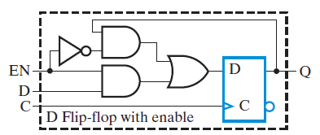
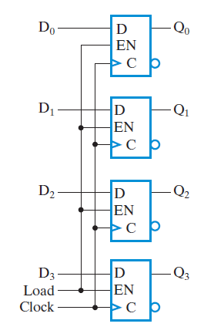
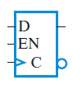
Example: 4-bit Register with Parallel Load

Slide 7
Digital Systems
Interconnected flip-flops and gates.
Sequential circuits – state tables
The number of states – prohibitively large!!!
Systems are composed of
Subsystems (modules) - modular and hierarchial approach
Modules are composed of
Functional blocks, registers, counters, decoders, multiplexers, buses, arithmetic elements, flip-flops
Modules communicate with data and control signals.

Slide 8
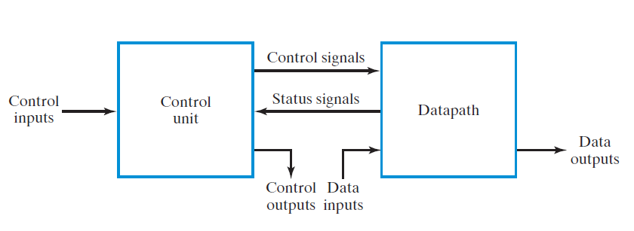
Digital Systems
Data path – performs data processing operations
Defined by their registers and the operations performed on binary data stored in the registers.
Registers are the basic components of the digital system!
Control unit – determines the sequence of operations

Slide 9
Register Transfer Operations
Register Transfer Operations – The movement and processing of data stored in registers
Three basic components:
set of registers
operations
control of operations
Elementary Operations -- load, count, shift, add, bitwise "OR", etc.
Elementary operations called microoperations

Slide 10
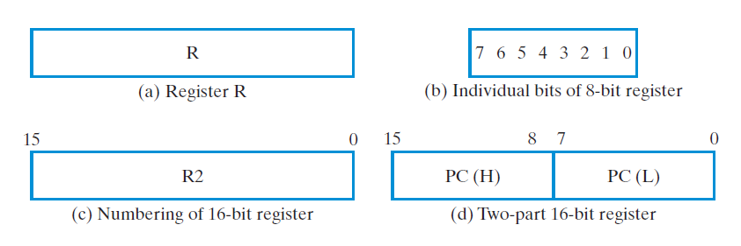
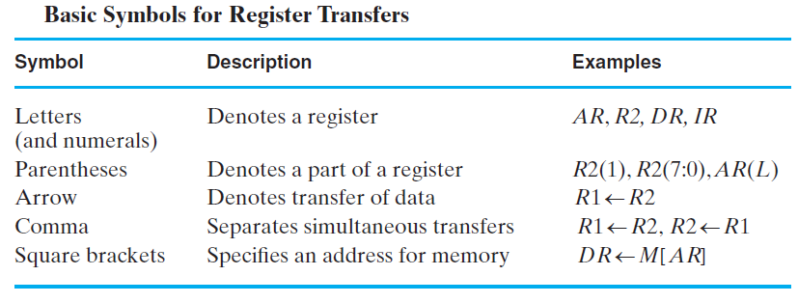
Register Notation

Slide 11
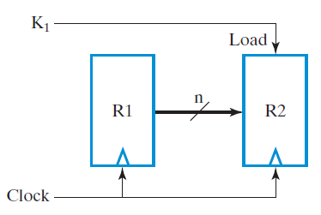
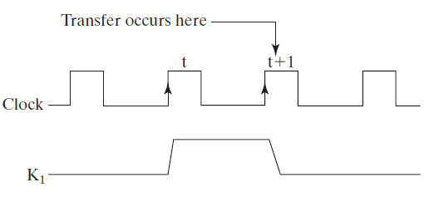
Conditional Transfer
If (K1 =1) then (R2 ← R1) is shortened to
K1: (R2 ← R1)
where K1 is a control variable specifying a conditional execution of the microoperation.

Slide 12
Microoperations

Slide 13
Microoperations
Logical Groupings:
Transfer - move data from one register to another
Arithmetic - perform arithmetic on data in registers
Logic - manipulate data or use bitwise logical operations
Shift - shift data in registers
Arithmetic operations + Addition – Subtraction * Multiplication / Division
Logical operations ∨ Logical OR ∧ Logical AND ⊕ Logical Exclusive OR ‾ Not

Slide 14
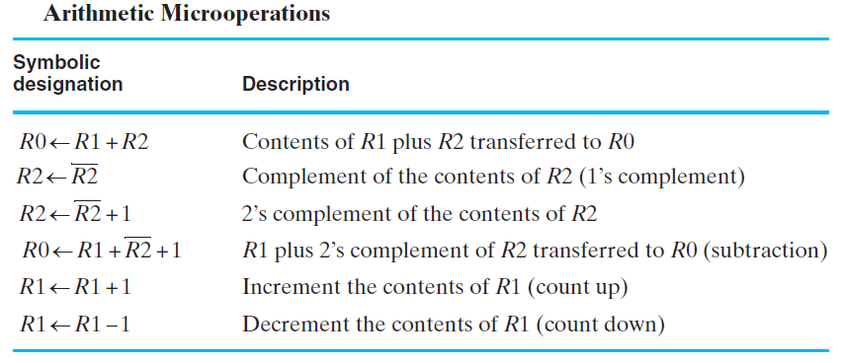
Arithmetic Microoperations
Note that any register may be specified for source 1, source 2, or destination.

Slide 15
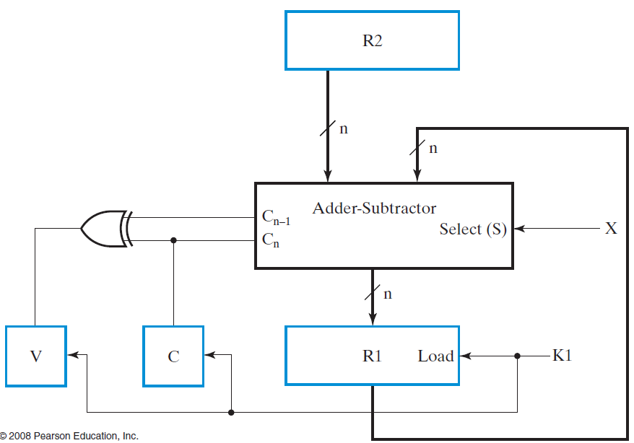
Example
X K1 : R1 ← R1 + R2 X K1 : R1 ← R1 + R2 + 1
Control variables K1 and X enables and selects the add or subtract operation.

Slide 16
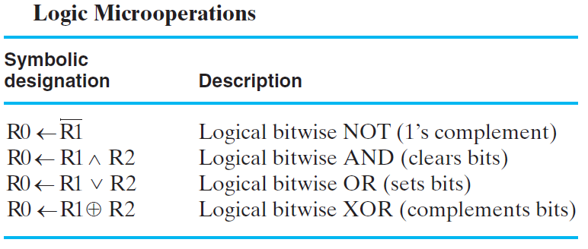
Logical Microoperations
R1 = 10101010
R2 = 11110000

Slide 17
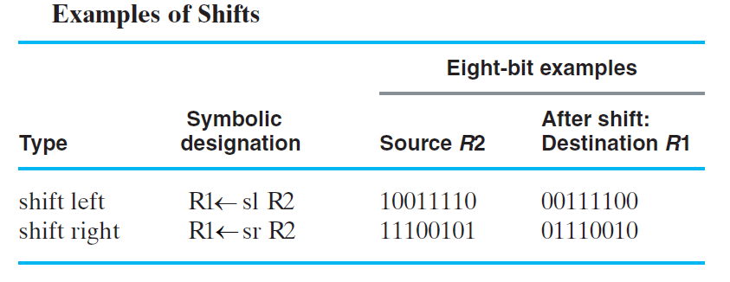
Shift Microoperations
Note: These shifts "zero fill". Sometimes a separate flip-flop is used to provide the data shifted in, or to “catch” the data shifted out.
Other shifts are possible (rotates, arithmetic)

Slide 18
Microoperations on a Single Register

Slide 19
Microoperations on a Single Register
We will consider the implementations of microoperations with a single register as the destination of all primary results.
The combinational logic implementing the microoperation is assumed to be a part of the register
Dedicated logic

Slide 20
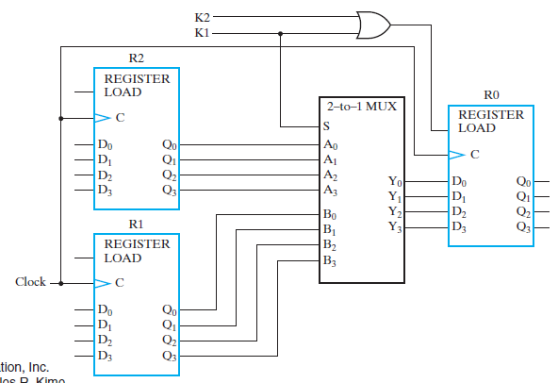
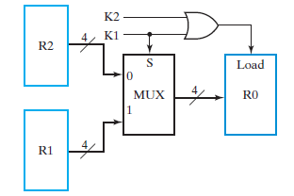
Multiplexer-Based Transfers
Multiplexers connected to register inputs produce flexible transfer structures (Note: Clocks are omitted for clarity)
K1: R0 ← R1 K2.K1: R0 ← R2

Slide 21
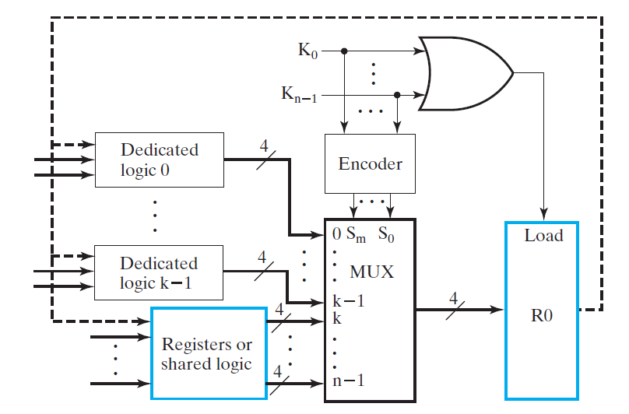
Generalization of Multiplexer Selection for n Sources

Slide 22
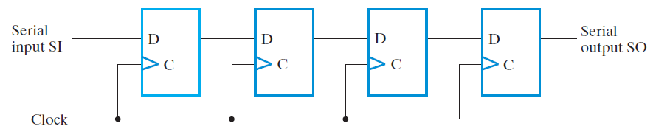
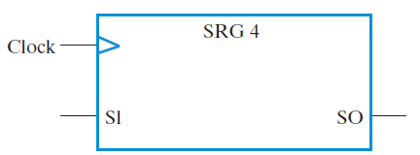
Shift Registers
Shift Registers move data laterally within the register toward its MSB or LSB position
In the simplest case, the shift register is simply a set of D flip-flops connected in a row like this:
Data input, In, is called a serial input or the shift right input.
Data output, Out, is often called the serial output.

Slide 23
Shift Registers (continued)
The behavior of the serial shift register is given in the listing on the lower right
T0 is the register state just before the first clock pulse occurs
T1 is after the first pulse and before the second.
Initially unknown states are denoted by “?”
Complete the last three rows of the table
In
A
B
C
Out
D
Q
D
Q
D
Q
D
Q
Clock CP
CP
In
A
B
C
Out
T0
0
?
?
?
?
T1
1
0
?
?
?
T2
1
1
0
?
?
T3
0
1
1
0
?
T4
1
T5
1
T6
1
Notes:
ROW T4: 10110
Row T5: 11011
Row T6: 11101

Slide 24
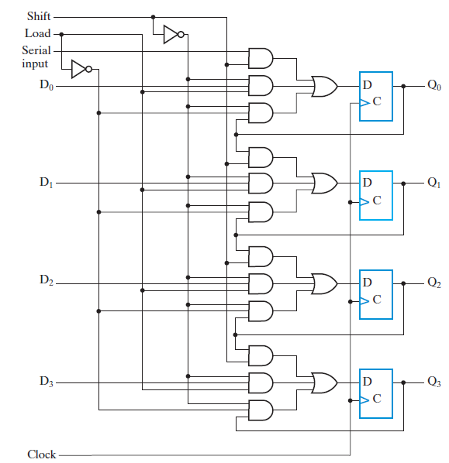
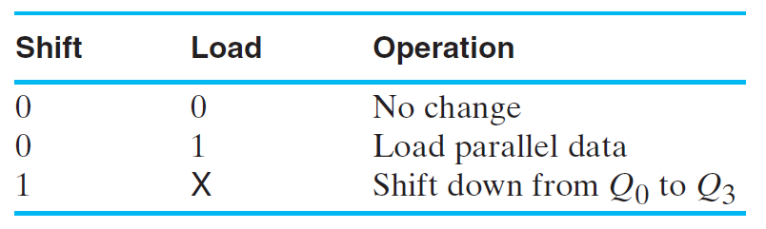
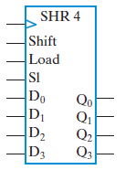
Parallel Load Shift Registers
By adding a mux between each shift register stage, data can be shifted or loaded.

Slide 25
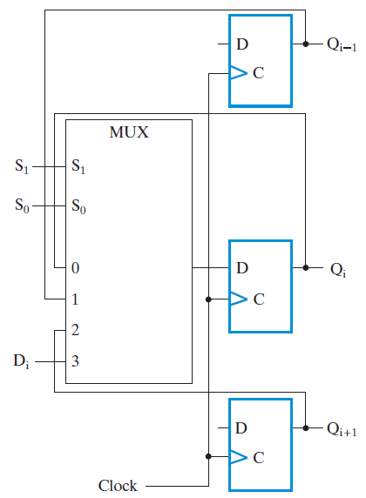
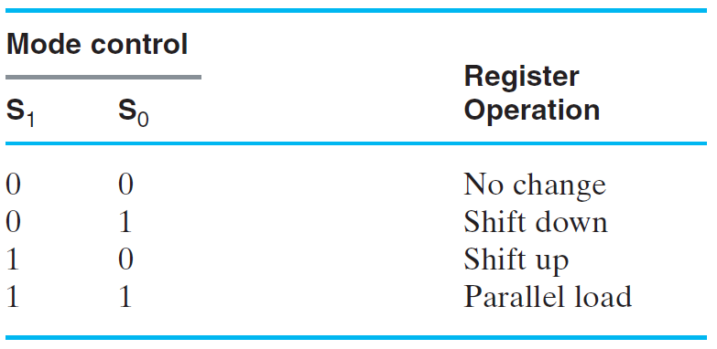
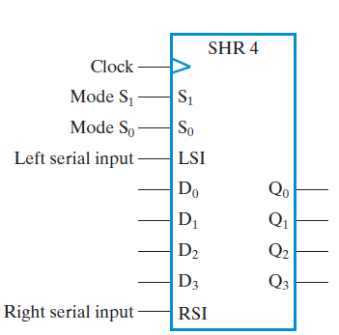
Bidirectional Shift Register

Slide 26
Counters
Counters are sequential circuits which "count" through a specific state sequence. They can count up, count down, or count through other fixed sequences. Two distinct types are in common usage:
Ripple Counters
Clock connected to the flip-flop clock input on the LSB bit flip-flop
For all other bits, a flip-flop output is connected to the clock input, thus circuit is not truly synchronous!
Output change is delayed more for each bit toward the MSB.
Resurgent because of low power consumption
Synchronous Counters
Clock is directly connected to the flip-flop clock inputs
Logic is used to implement the desired state sequencing

Slide 27
Ripple Counter
How does it work?
When there is a positive edge on the clock input of A, A complements
The clock input for flip- flop B is the complemented output of flip-flop A
When flip A changes from 1 to 0, there is a positive edge on the clock input of B causing B to complement.
D
A
Clock
C_{R}
D
B
C_{R}
Reset
CP
The changes “ripple” upward through the chain of flip-flops, i. e., each transition occurs after a clock-to-output delay from the stage before.
A
B
0
1
2
3
0
1

Slide 28
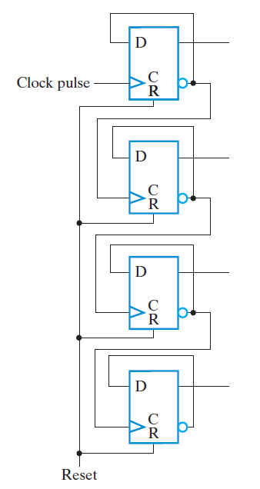
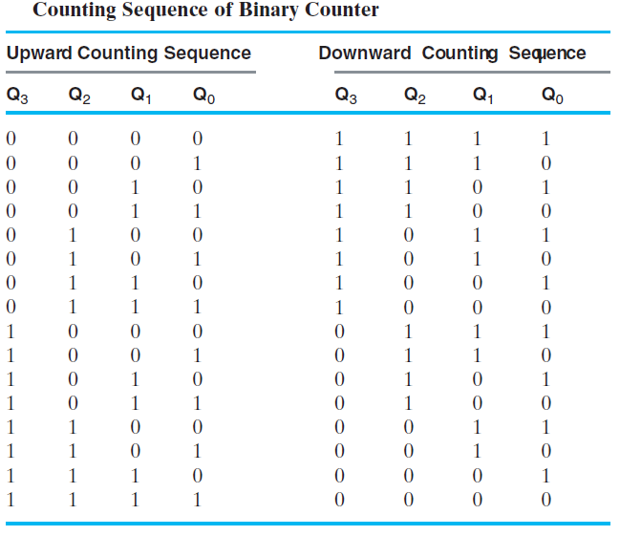
Ripple Counter (continued)

Slide 29
Ripple Counter (continued)
In fine timing detail:
The clock to output delay t_{PHL} causes an increasing delay from clock edge for each stage transition.
Thus, the count “ripples” from least to most significant bit.
For n bits, total worst case delay is n t_{PHL}.
tPHL
CP
tPHL
A
tpHL
B
C
Not good for delay-dependent circuits!

Slide 30
Synchronous Counters
To eliminate the "ripple" effects, use a common clock for each flip-flop and a combinational circuit to generate the next state.
For an up-counter, use an incrementer =>
Incre-menter
A3
S3
D3
Q3
A2
S2
D2
Q2
A1
S1
D1
Q1
A0
S0
D0
Q0
Clock

Slide 31
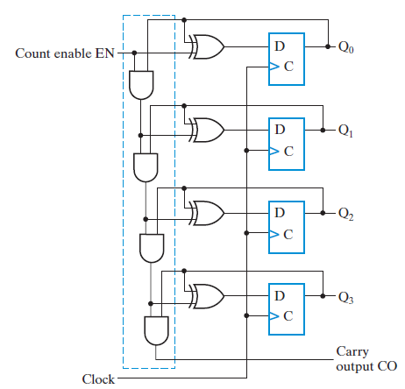
Synchronous Counters (continued)
Internal Logic
Half Adders to increment the value stored in the flip-flops
Count Enable
Forces all outputs of AND chain to 0 to “hold” the state
Carry Out
Added as part of incrementer
Connect to Count Enable of additional 4-bit counters to form larger counters

Slide 32
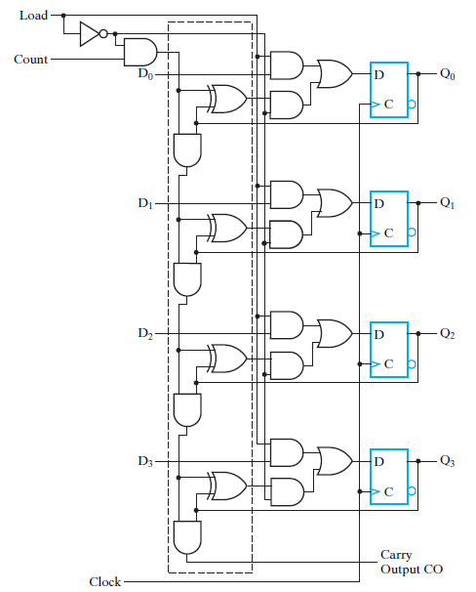
Counter with Parallel Load
Add path for input data
enabled for Load = 1
Add logic to:
disable count logic for Load = 1
disable feedback from outputs for Load = 1
enable count logic for Load = 0 and Count = 1
The resulting function table:
Load | Count | Action
0 | 0 | Hold Stored Value
0 | 1 | Count Up Stored Value
1 | X | Load D

Slide 33
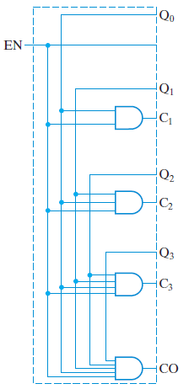
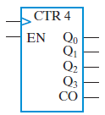
Synchronous Counters (continued)
Carry chain
series of AND gates through which the carry “ripples”
Yields long path delays
Called serial gating
Replace AND carry chain with ANDs
in parallel
Reduces path delays
Called parallel gating

Slide 34
Design Example: Synchronous BCD
Use the sequential logic model to design a synchronous BCD counter with D flip-flops
Input combinations 1010 through 1111 are don’t cares
Current State
Next State
Q8 Q4 Q2 Q1
Q8 Q4 Q2 Q1
0 0 0 0
0 0 0 1
0 0 0 1
0 0 1 0
0 0 1 0
0 0 1 1
0 0 1 1
0
1 0 0
0 1 0 0
0 1 0 1
0 1 0 1
0 1 1 0
0 1 1 0
0 1 1 1
0 1 1 1
1 0 0 0
1 0 0 0
1 0 0 1
1 0 0 1
0 0 0 0

Slide 35
Synchronous BCD (continued)
Use K-Maps to two-level optimize the next state equations and manipulate into forms containing XOR gates: D1 = Q1 D2 = Q2 + Q1Q8 D4 = Q4 + Q1Q2 D8 = Q8 + (Q1Q8 + Q1Q2Q4)
The logic diagram can be draw from these equations
An asynchronous or synchronous reset should be added
What happens if the counter is perturbed by a power disturbance or other interference and it enters a state other than 0000 through 1001?

Slide 36
Synchronous BCD (continued)
Find the actual values of the six next states for the don’t care combinations from the equations
Find the overall state diagram to assess behavior for the don’t care states (states in decimal)
0
Present State | Next State
Q8 Q4 Q2 Q1 | Q8 Q4 Q2 Q1
1 0 1 0 | 1 0 1 1
1 0 1 1 | 0 1 1 0
1 1 0 0 | 1 1 0 1
1 1 0 1 | 0 1 0 0
1 1 1 0 | 1 1 1 1
1 1 1 1 | 0 0 1 0
9
1
14
8
2
15
12
7
11
13
3
6
10
4
5

Slide 37
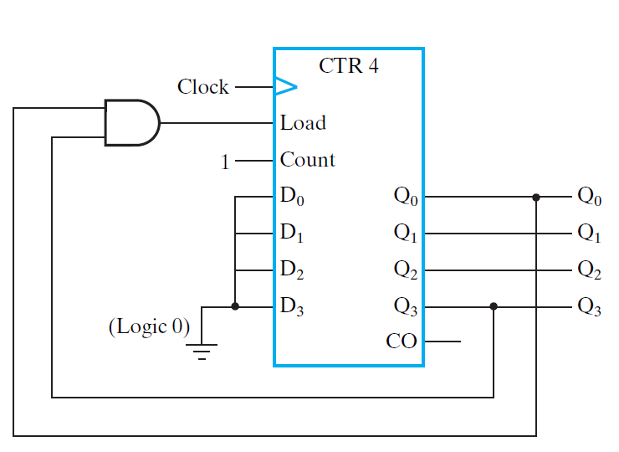
Synchronous BCD

Slide 38
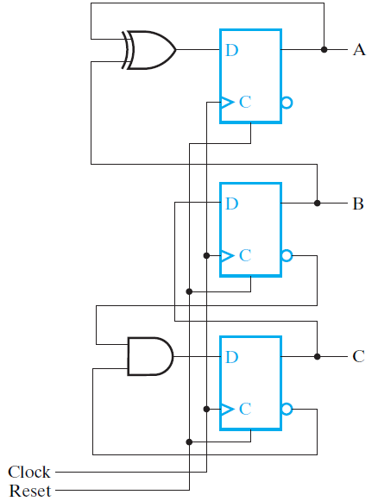
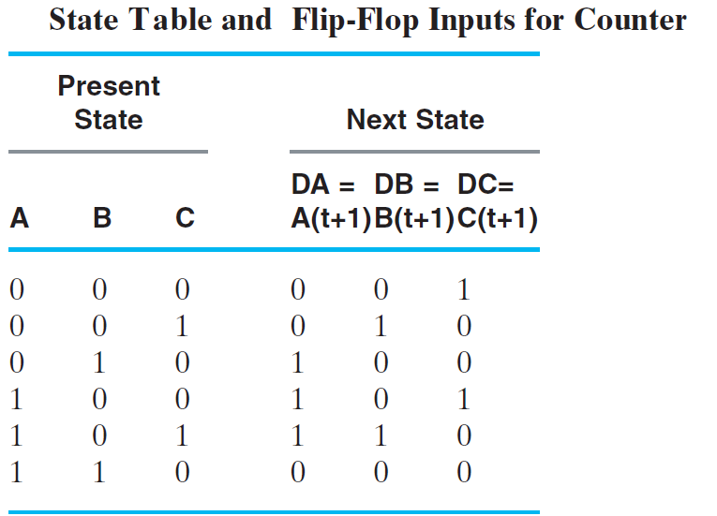
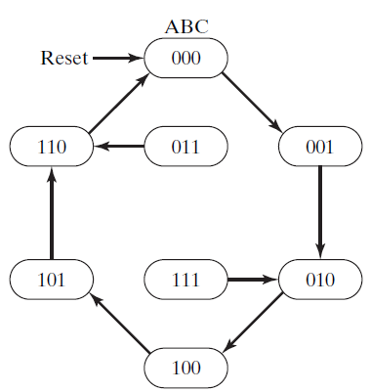
Arbitrary Count Sequence

Slide 39
Register Cell Design

Slide 40
Register Cell Design
Assume that a register consists of identical cells
Then register design can be approached as follows:
Design representative cell for the register
Connect copies of the cell together to form the register

Slide 41
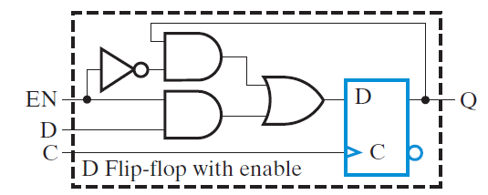
Example 1: Design-1
Implement the following register transfers:
AND: (A ← A . B)
EXOR: (A ← A + B)
OR: (A ← A + B)
LOAD= AND + EXOR + OR
A(t+1)_{i} =AND.A_{i} B_{i} + EXOR.(A_{i} B_{i} +A_{i} B_{i}) + OR(A_{i} +B_{i})

Slide 42
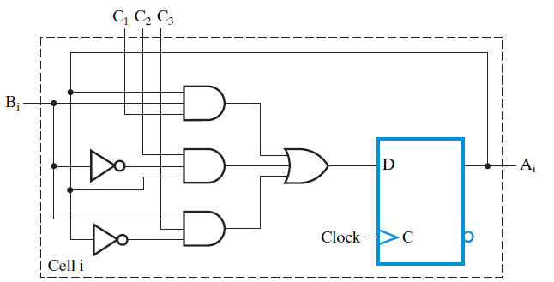
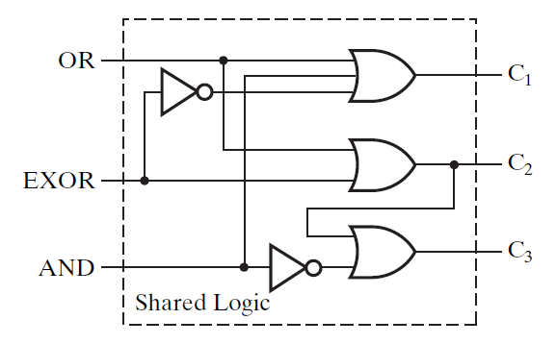
Example 1: Design -2
A(t+1)_{i} =AND.A_{i} B_{i} + EXOR.(A_{i} B_{i} +A_{i} B_{i}) + OR(A_{i} +B_{i}) + (AND+EXOR+OR) A_{i}
=(AND+OR+EXOR).A_{i} B_{i} + (EXOR+OR+AND).A_{i} B_{i} + (EXOR+OR).A_{i} B_{i}
REDUCED COST!!!

Slide 43
Multiplexer and Bus-Based Transfers for Multiple Registers

Slide 44
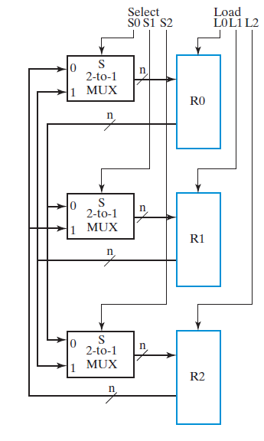
Dedicated MUX-Based Transfers
A digital system has many registers!
Paths must be provided top transfer data from one register to another.
Bus – a shared transfer path
Multiplexer connected to each register input produces a very flexible transfer structure
Characterize the simultaneous transfers possible with this structure.
Notes:
There can be three distinct registers as source, so can simultaneously do any three register transfers
- totally flexible.

Slide 45
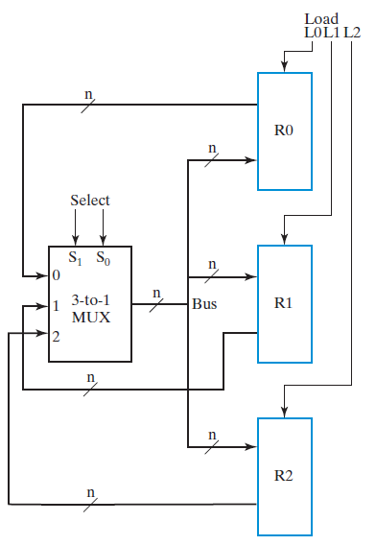
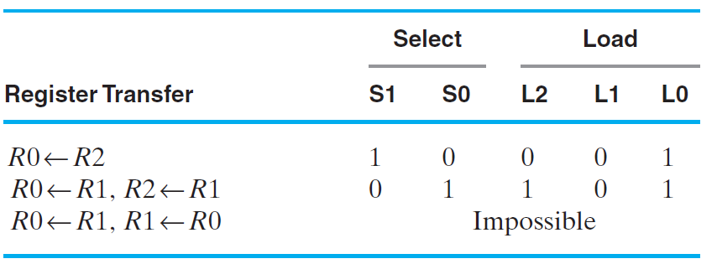
Multiplexer Bus
A single bus driven by a multiplexer lowers cost, but limits the available transfers
Characterize the simultaneous transfers possible with this structure.
Characterize the cost savings compared to dedicated multiplexers
Notes:
Can have only one register as a source at a time. Thus a set of simultaneous transfers
can have only one register source. Could require up to three clock cycles if three different sources needed.
Costs:
Dedicated 18 gate inputs per bit plus 3 shared inverters with total of 3 inputs
Bus: 9 gate inputs per bit + shared decoder with 8 inputs
Bus clearly less costly.

Slide 46
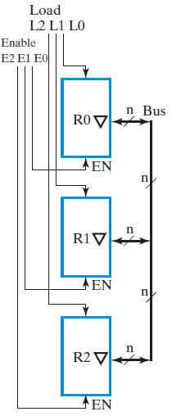
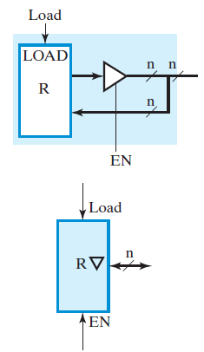
Three-State Bus
The 3-input MUX can be replaced by a 3-state node (bus) and 3-state buffers.
Cost is further reduced, but transfers are limited
Notes:
Same simultaneous transfer capability as multiplexer bus
Cost: 3 gate inputs per three state driver = 9 gate inputs
If decoder desired, 8 shared gate inputs.
Clearly least costly.
The “bus” is unique in that it is “bidirectional.” This is a significant advantage
since it cuts connections between chips for bus paths to 1/2.

Slide 47
Serial Transfer and Microoperations

Slide 48
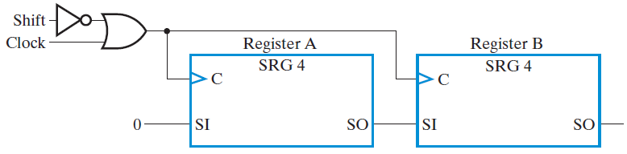
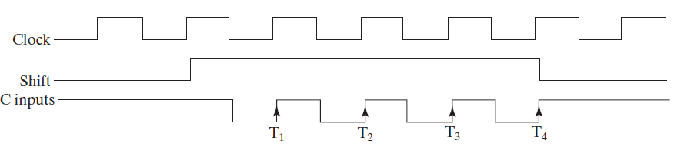
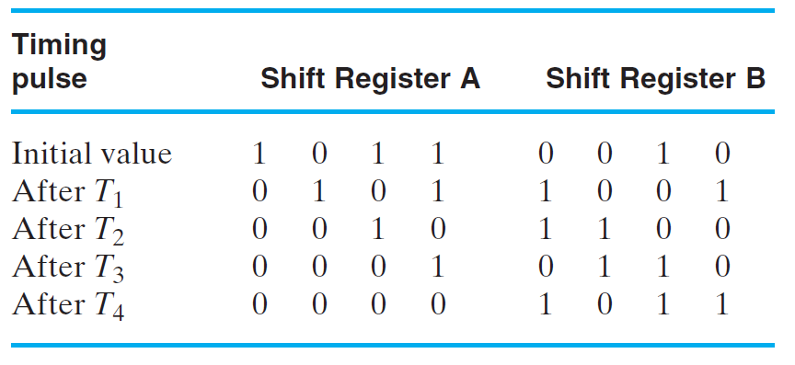
Serial Transfers and Microoperations
Serial Transfer from register A to B

Slide 49
Serial Adder
Load/Right Shift Registers
The circuit shown uses two shift registers for operands A(3:0) and B(3:0).
The result is stored in the A register and the final carry in the flip-flop
Serial
In
A
FA
A3 A2 A1 A0
B
Sum
Parallel Load
Cin
Serial
Cout
In
B3 B2 B1 B0
Parallel Load
Q
D
(Clock and Load/Shift
CP
Control not shown)

Slide 50
Control of Register Transfers

Slide 51
Programmable and Non-Programmable Systems
Programmable System
a portion of the input consists of a sequence of instructions called a program
typically stored in a memory and addressed by a program counter
the Control Unit is responsible for fetching and executing these instructions.
Non-programmable System
the control unit does not deal with fetching and executing instructions
but contains all of the information for sequencing register transfers based on inputs and on status bits from the datapath.
Only non-programmable designs are considered here.

Slide 52
Register Transfer System Design Procedure
Write a detailed system specification
Determine all data, control and status input signals, all data, control and status output signals, and registers of the datapath and control unit.
Find a state machine diagram for the system including register transfers for the datapath and control unit as outputs.
Determine all internal control and status signals. Use these signals to separate output conditions and actions, including register transfers, from the state machine diagram flow and represent them in tabular form.
Draw a block diagram of the datapath including all control and status inputs and outputs. Draw a block diagram of the control if it includes register transfer hardware.
Design any specialized register transfer logic as needed for the datapath and the control.
Design the control unit logic.
Verify the correct operation of the combined datapath and control unit. If verification fails, debug the system and verify the changed system.

Slide 53
The State Machine Diagram Model (SMD)
Input Variables A, B, C Output Variables Y, Z Default: Y = 0, Z = 0
S0
A⋅B
S1
S0
A⋅B
S1
A + B
Transition condition (TC)
A + B
Y, Z
A/Y, B/Z
S2
S2
Transition condition-independent (TCI)
Moore Outputs
TCI Outputs
Transition condition-dependent (TCD)
A⋅B/Y
C/Y
S0
S1
A⋅B
S0
S1
(A + B)/Z
C/Y
(A + B)
S2
S2
Transition and output condition-dependent (TCOD)
TCD Outputs
TCOD Outputs

Slide 54
Example-1
Defaults: Y = 0, Z = 0
Y, Z
A/Y, B/Z
S0
A⋅B
S1
A + B
BC
A/Z
A⋅C
A + C
B⋅C
A/Y
(B + C)/Z
S3
S2
B⋅C/Y
What is the state diagram for this SMD?

Slide 55
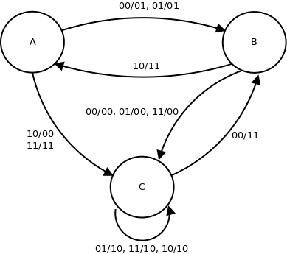
Example-2
What is the SMD for this state diagram?

Slide 56
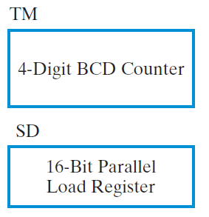
Design Example – DASHWATCH - Specs
START
Display Time
STOP
CSS
RESET
Times intervals to at most 99.99 seconds
Stopwatch action and storage of best performance time per session (session ended by turning off power or pushing RESET)

Slide 57
Design Example – DASHWATCH - Specs
Symbol | Function | Type
START | Initialize timer to 0 and start timer | Control input
STOP | Stop timer and display timer | Control input
CSS | Compare, store and display shortest dash time | Control input
RESET | Set shortest value to 10011001 | Control input
B₁ | Digit 1 data vector a,b,c,d,e,f,g to display | Data output vector
B₀ | Digit 0 data vector a,b,c,d,e,f,g to display | Data output vector
DP | Decimal point to display (=1) | Data output
B₋₁ | Digit -1 data vector a,b,c,d,e,f,g to display | Data output vector
B₋₂ | Digit -2 data vector a,b,c,d,e,f,g to display | Data output vector
B | The 29-bit display input vector(B₁,B₀,DP,B₋₁,B₋₂) | Data output vector
TM | 4-Digit BCD counter | 16-Bit register
SP | Parallel load register | 16-Bit register

Slide 58
DASHWATCH – Registers (BCD Counter)
BCD Counter
How to design 4-digit BCD Counter?
0.01 seconds = 100Hz must be the clock of the circuit
Binary Counter with Parallel Load

Slide 59
State Machine Diagram
START
Display Time
START
CONTROL
RSTM
DATA PATH
STOP
STOP
ENTM
CSS
UPDATE
CSS
RESET
RESET
LSR
DIS
ALTB
RESET
S1
LSR
SD<-(9999)_{BCD}
Action or Status | Control or Status Signals | Meaning for Values 1 and 0
TM <- (0000)_{BCD} | RSTM | 1: reset TM to 0 0: no reset of TM
TM <- (TM+1)_{BCD} | ENTM | 1: BCD count up TM by 1, 0: hold TM value
SD <- (9999)_{BCD} | UPDATE LSR | 0: select 1001100110011001 for SD 1: Enable load SD, 0:disable load SD
SD <- TM | UPDATE LSR | 1: Select TM for DIS Same as above
DIS = TM DIS = SD | DS | 0: Select TM for DIS 1: Select SD for DIS
TM < SD TM >= SD | ALTB | 1: TM less than SD 0: TM greater than or equal to SD
START
RSTM
S2
TM<-(0000)_{BCD}
START
CSS·START
STOP
S3
ENTM,
TM<-(TM+1)_{BCD}, DIS=TM
STOP
S4
CSS·START
DIS=TM
CSS
S5
ALTB
ALTB’
TM<SD
TM>=SD
START
S7
S6
LSR, UPDATE
SD<-TM
DIS
START
DIS=SD

Slide 60
START
STOP
CSS
RESET
Action or Status | Control or Status Signals | Meaning for Values 1 and 0
TM <- (0000)_{BCD} | RSTM | 1: reset TM to 0 0: no reset of TM
TM <- (TM+1)_{BCD} | ENTM | 1: BCD count up TM by 1, 0: hold TM value
SD <- (9999)_{BCD} | UPDATE LSR | 0: select 1001100110011001 for SD 1: Enable load SD, 0:disable load SD
SD <- TM | UPDATE LSR | 1: Select TM for DIS Same as above
DIS = TM DIS = SD | DS | 0: Select TM for DIS 1: Select SD for DIS
TM < SD TM >= SD | ALTB | 1: TM less than SD 0: TM greater than or equal to SD
CONTROL
DS
RSTM
ENTM
UPDATE
LSR
ALTB
TM
4-Digit BCD Counter
C0
SRST
A<B Comparator
D1
D0
S
16-Bit 2-to-1 MUX
SD
LOAD
DIS
Storage Register
RESET
4-Digit BCD-to-7
RESET
D
Segment Converter
16-Bit 2-to-1 MUX
D1
D0
4-Digit LCD Display
DP
1
1001100110011001

Slide 61
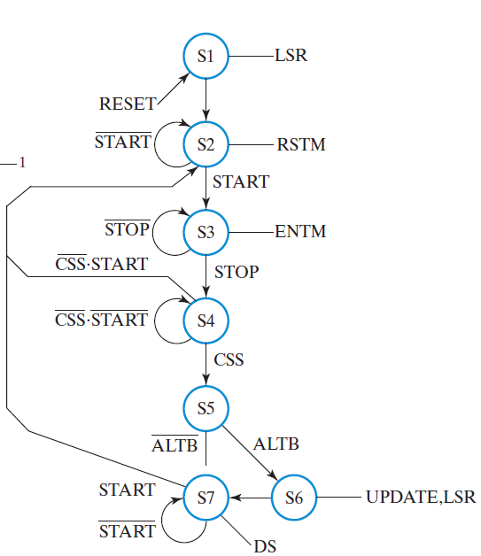
Flip-Flop Input Equations One-Hot State Assignment – 7 bits State S1 entered only by using asynchronous RESET
Control
State
Machine
(RESET)
Output Equations

Slide 62
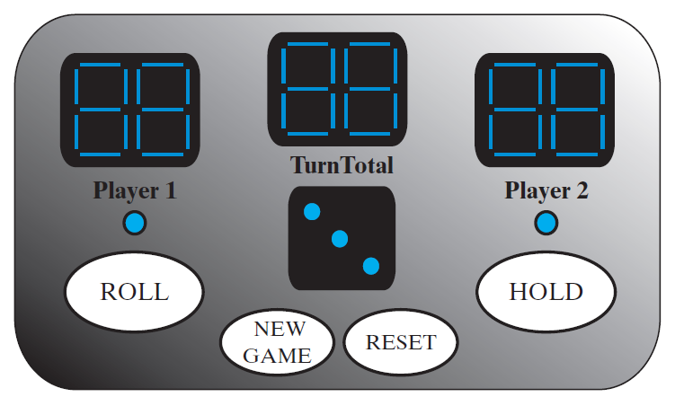
Design Example – PIG
Each turn, a player repeatedly rolls a die until either a 1 is rolled or the player decides to "hold”
If the player rolls a 1, they score nothing and it becomes the next player's turn.
If the player rolls any other number, it is added to their turn total and the player's turn continues.
If a player chooses to "hold", their turn total is added to their score, and it becomes the next player's turn.
The first player to score 100 or more points wins.

Slide 63

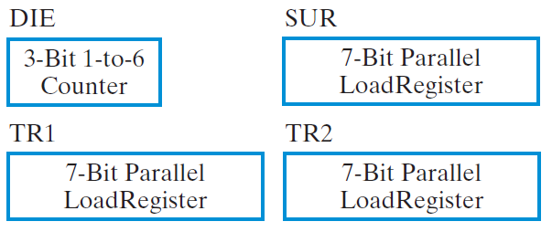
Design Example – PIG - Specs
Symbol | Function | Type
ROLL | 1: Starts die rolling, 0: Stops die rolling | Control input
HOLD | 1: Ends player turn, 0: Continues player turn | Control input
NEWGAME | 1: Starts new game, 0: Continues current game | Control input
RESET | 1: Resets game to INIT state, 0: No action | Control input
DIE | DIE value-Specialized Counter to count 1..6 | 3-Bit data register
SUR | Subtotal for active player-parallel load register | 7-bit data register
TR1 | Total for player 1-parallel load register | 7-bit data register
TR2 | Total for player 2-parallel load register | 7-bit data register
FP | First player-flip-flop 0:Player 1, 1:Player 2 | 1-bit control register
CP | Current player | 1-bit control register

Slide 64

Default: P1=CP, P2=CP
RESET
DIE←000, FP<-0
INIT
TR1<-0, TR2<-0, CP<-FP
SUR<-0
Design Control and Datapath !!
ROLL
BEGIN
ROLL
ROLL
ROL
If (DIE=110) DIE<-001
Else DIE<-(DIE+1)
CP<-CP
DIE=1
ROLL
ONE
SUR<-SUR+DIE
ROLL·HOLD
DIE<>1
ROLL
CP<-CP
ROH
CP/(TR1<-TR1+SUR),
CP/(TR2<-TR2+SUR)
CP(TR1<1100100)
+CP(TR2<1100100)
ROLL·HOLD
TEST
FP<-FP
NEWGAME
CP(TR1>=1100100)+CP(TR2>=1100100)
WIN
CP/P1=BLINK, CP/P1=BLINK
NEWGAME

Slide 65
Microprogrammed Control
Microprogrammed Control — a control unit with binary control values stored as words in memory.
Microinstructions — words in the control memory.
Microprogram — a sequence of microinstructions.
Control Memory — RAM or ROM memory holding the microinstructions.
Writeable Control Memory — RAM Memory into which microinstructions may be written

Slide 66
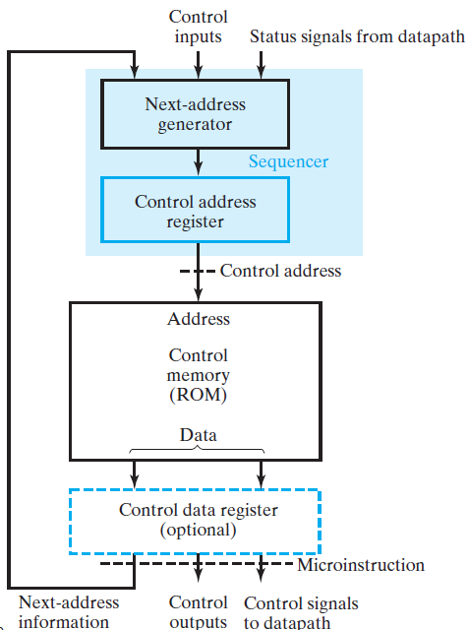
Microprogrammed Control (continued)

